Slide 1


Slide 2
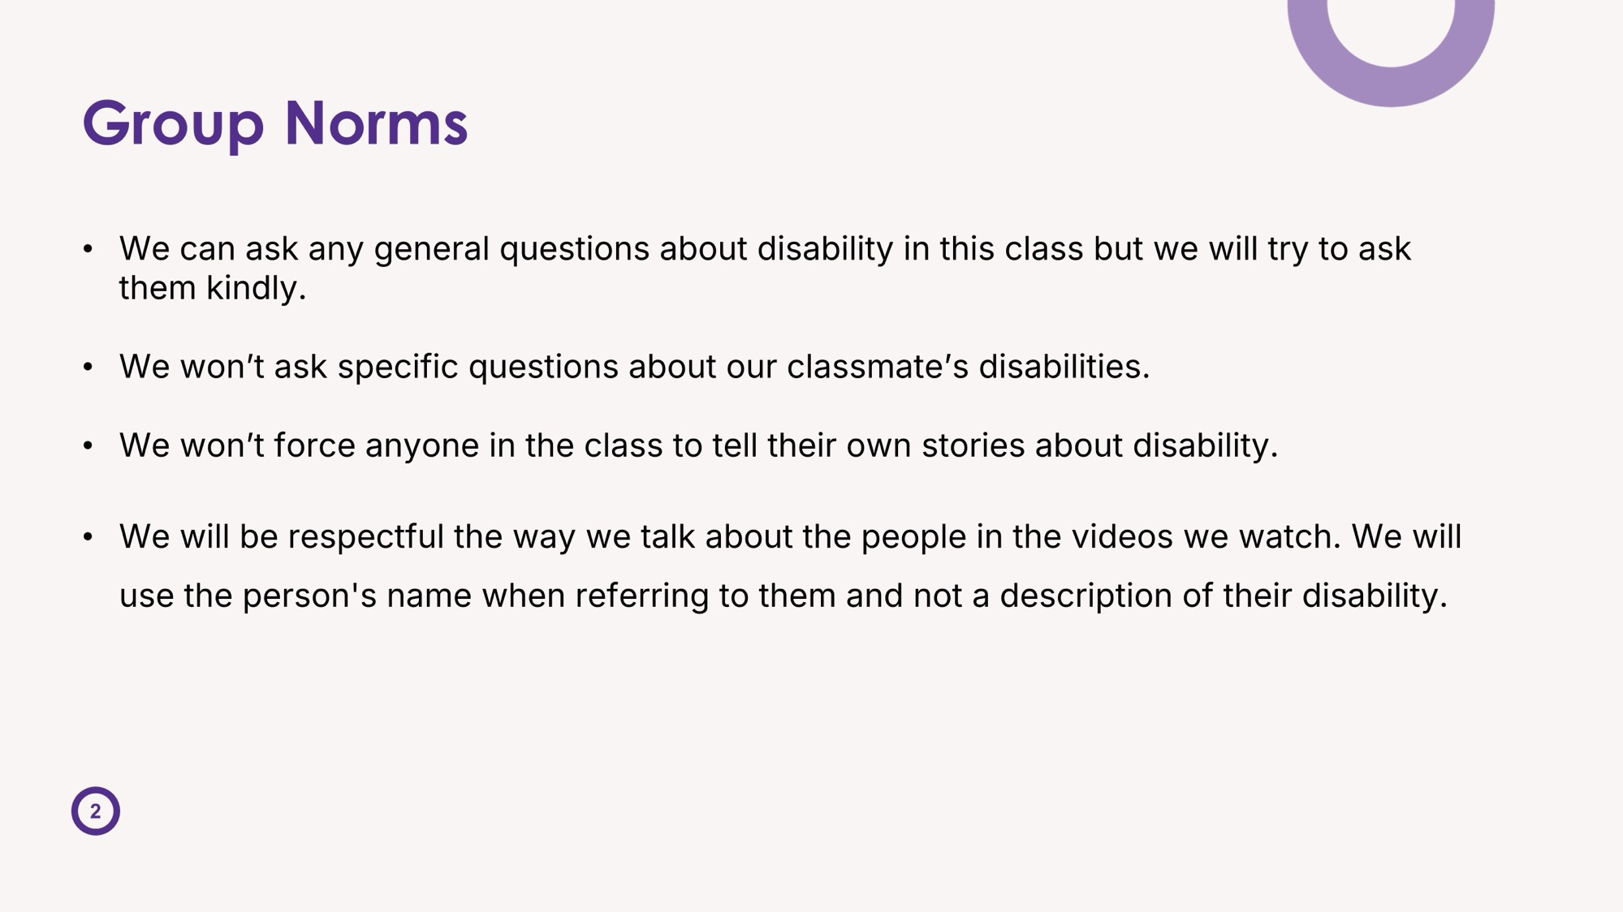

Slide 3
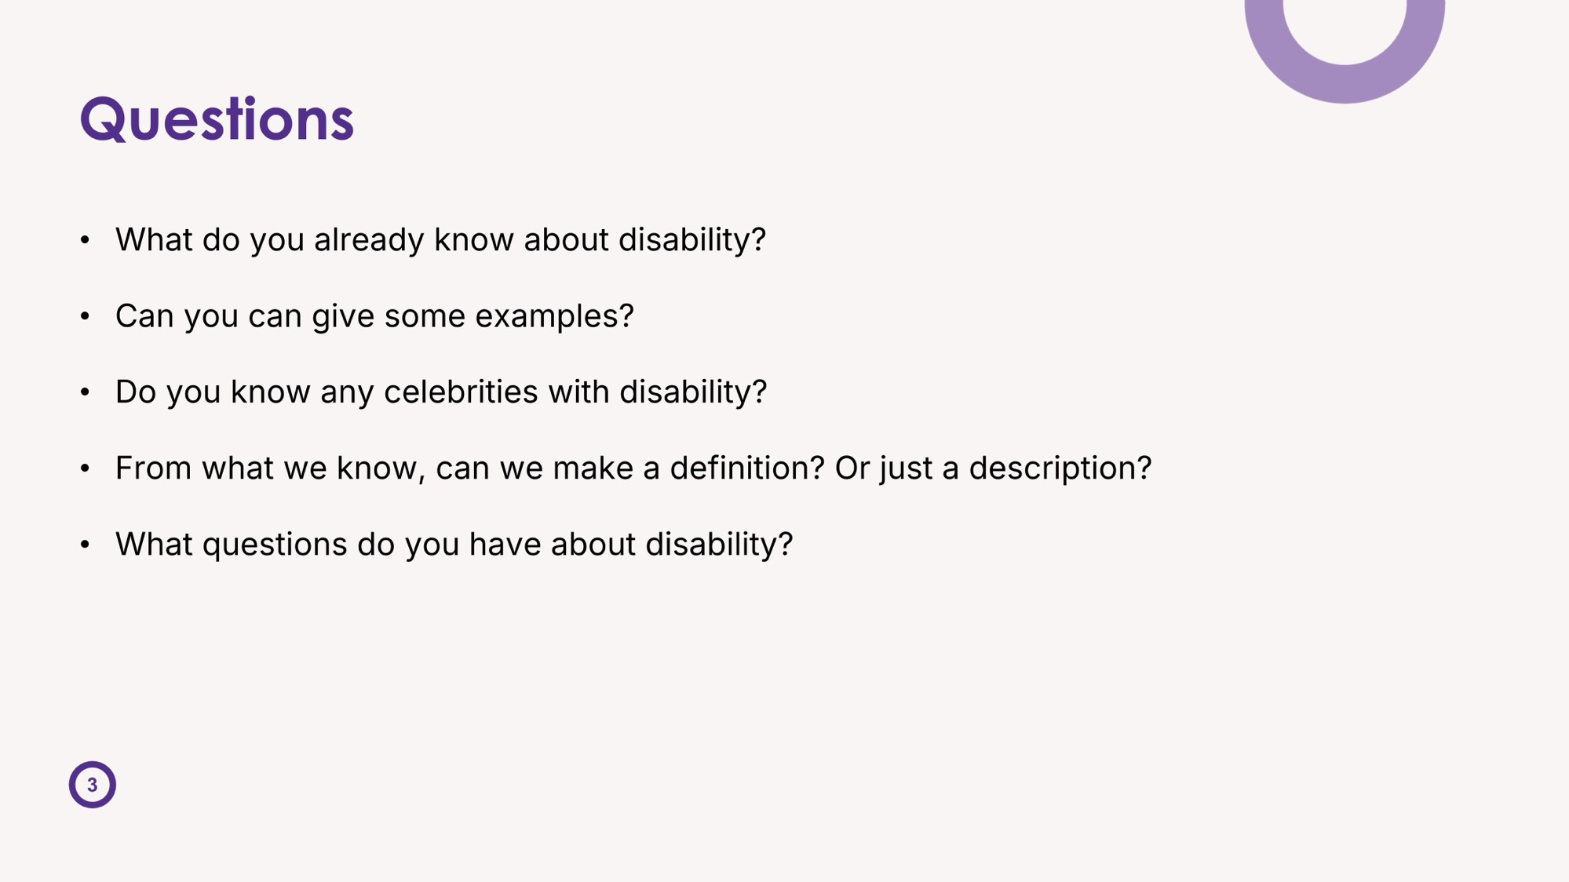

Slide 4
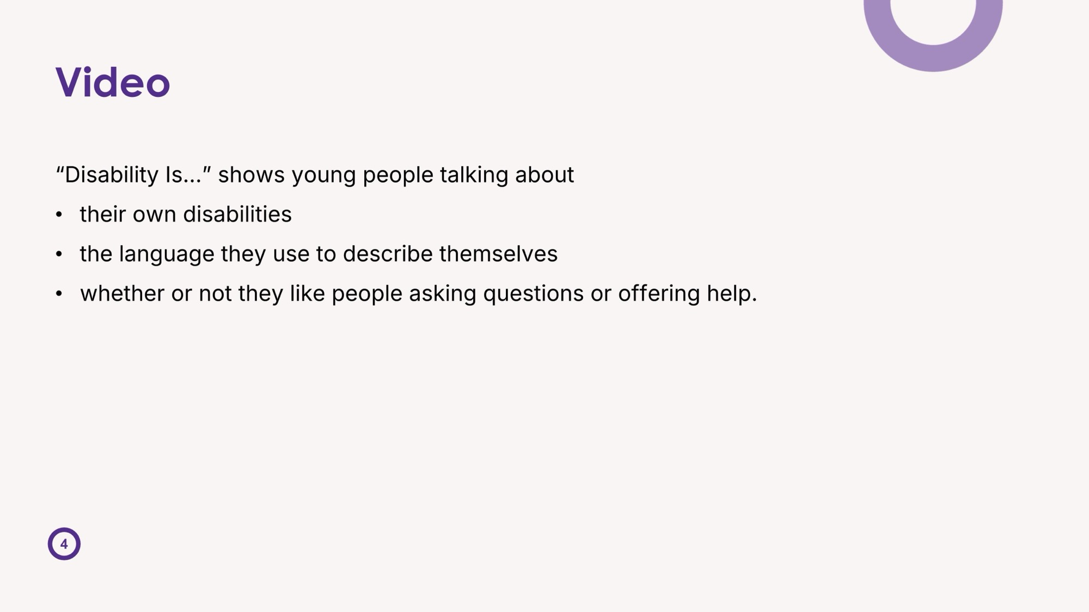

Slide 5


Slide 6
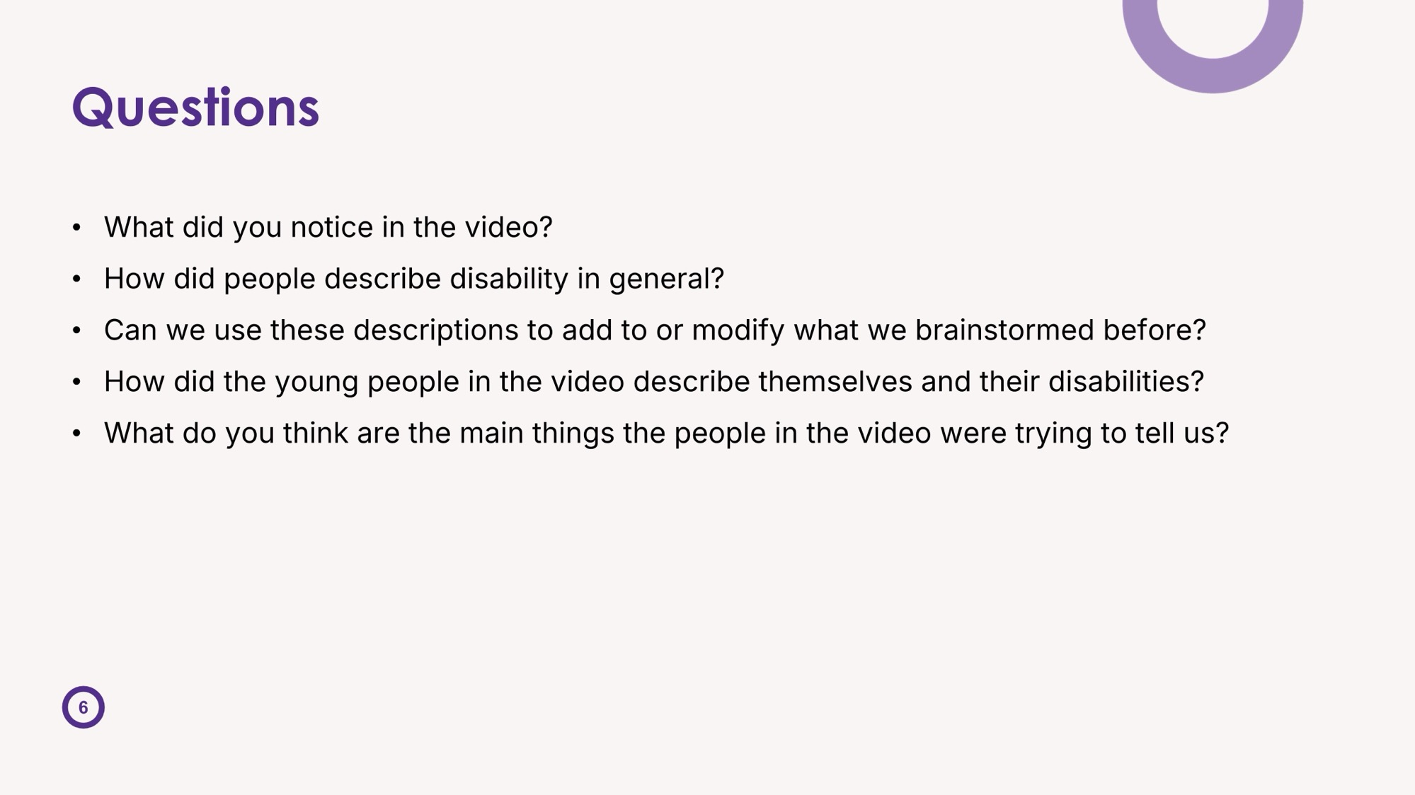

Slide 7
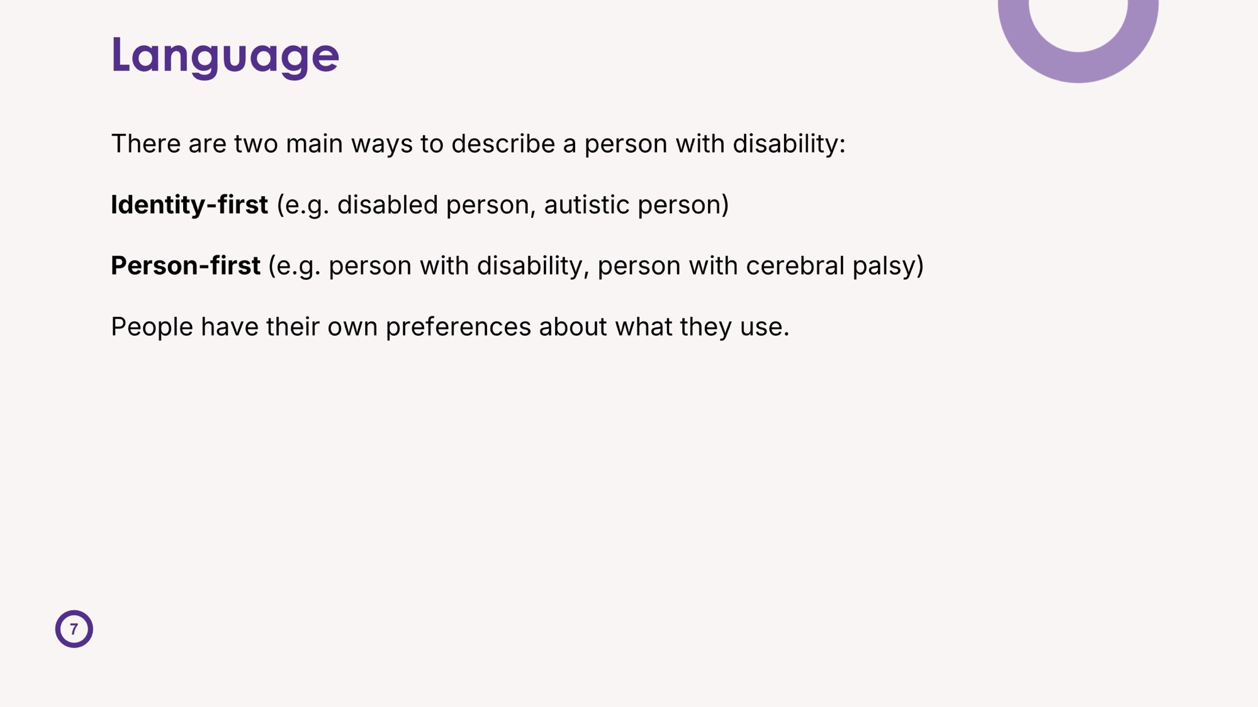

Slide 8
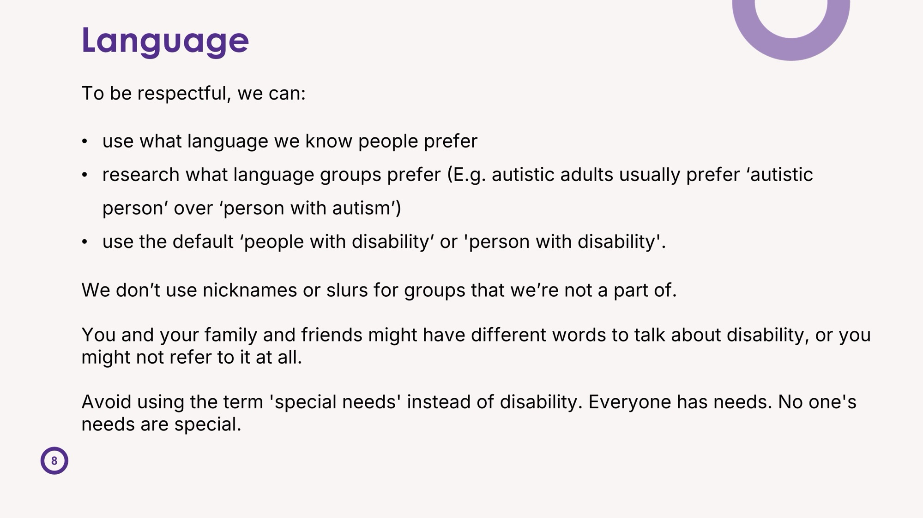

Slide 9

Not 'special' needs
"NOT SPECIAL NEEDS” video by CoorDown for World Down Syndrome Day in 2017. https://www.youtube.com/watch?v=kNMJaXuFuWQ&t=97s

Slide 10
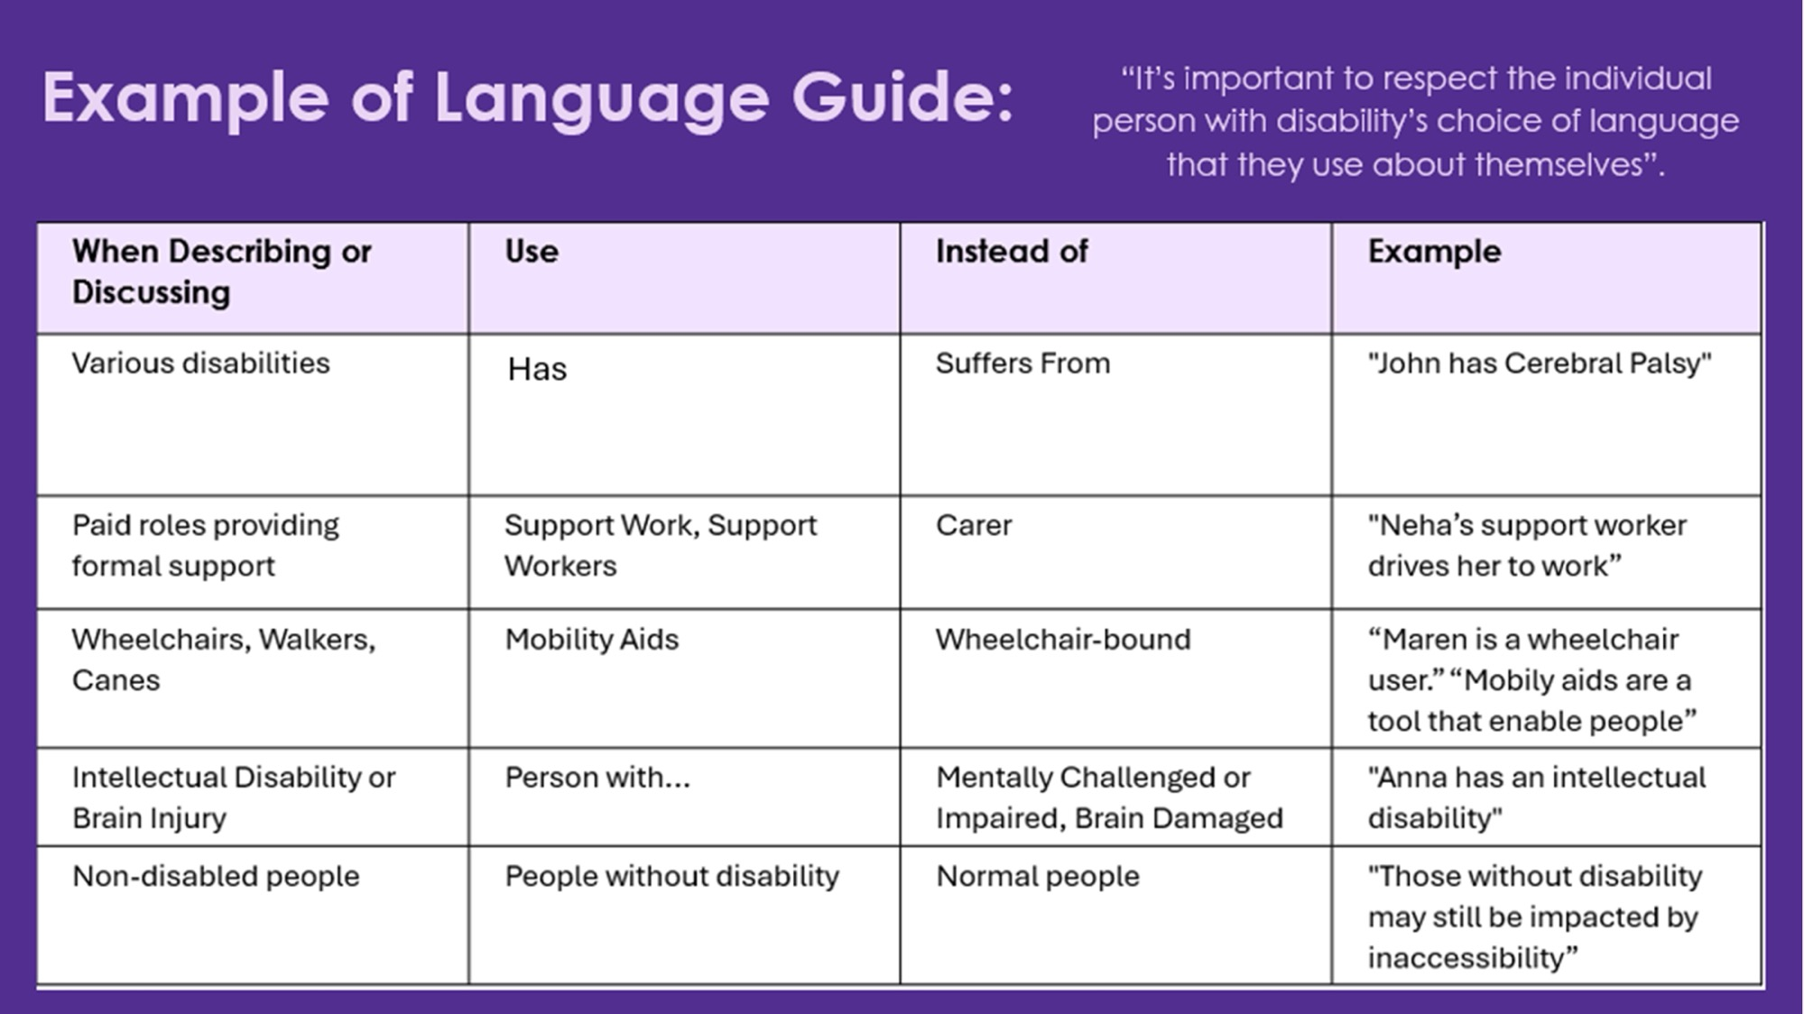

Slide 11
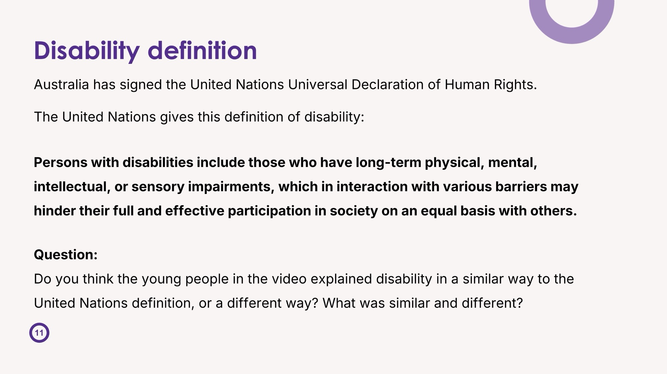

Slide 12
Task
Answer these questions in a 200-300 written response.
Do you think it’s unkind to ask about someone’s disability? Why?
2. Is there ever a time when it’s not unkind? Why
3. What did the young people in the video say about asking questions about their disabilities, and did that influence your answers?

Slide 13


